Slide 1
Discussion of Investor Participation
November 5, 2010

Slide 2
Companies Realized Additional Savings on Print and Postage
Estimated Savings to Date for FY10 from Notice and Access: $233 Million
Estimated Savings to Public Companies from Use of Notice and Access with Beneficial Shareholders
$300M
$200M
$100M
0
By sending a Notice instead of a full set of materials, Notice and Access provides an additional method to save on printing and postage.
    $238
    7/1/08-6/30/09
    $233
    7/1/09-6/30/10
Est. N&A Savings 1363 Companies*
Est. N&A Savings 1601 Companies*
* Net of service fees
The 2010 unit savings estimate is based on information from NIRI and Broadridge internal data. It includes a median Annual Report cost of $ 4.32 per NIRI. and an average actual postage cost per package of $ 1.45 per Broadridge.
The 2009 unit savings estimate is based on comparable data from NIRI and Broadridge.

Slide 3
Companies Using Notice and Access
Retail Voting Response by Distribution Method by Shares
% Shares Voted
Last Year (7/1/08-6/30/09)
Current Year (7/1/09-6/30/10)
100%
90%
80%
70%
60%
50%
40%
30%
20%
10%
0
    86.66%
    87.22%
    81.88%
    78.70%
    73.93%
    73.07%
    70.66%
    66.91%
    29.20%
    31.8%
    31.01%
    28.70%
    15.28%
    18.12%
Notice Recipients
Shareholders who received a notice only
Full Package
by Consent
Shareholders who previously requested to always receive full package materials
Full Package by Fulfillment
Shareholders who received a notice and requested full package materials
Full Package by Stratification
Shareholders who received full package materials because the issuer chose to send full package materials to a subset of shareholders
Total Actual Retail Returns
Actual retail vote instructions received
Total Actual Returns – All Shareholders
Actual vote instructions received from all shareholders
Total Quorum
All shares voted including broker vote

Slide 4
Companies NOT Using Notice and Access
Retail Voting Response
% Accounts Voted
% Shares Voted
100%
90%
80%
70%
60%
50%
40%
30%
20%
10%
0
100%
90%
80%
70%
60%
50%
40%
30%
20%
10%
0
    79.66%
    83.06%
    74.23%
    81.59%
    76.38%
    61.44%
    57.70%
    31.95%
    24.02%
    22.65%
    27.29%
    19.39%
    13.48%
    19.21%
    14.28%
Total Actual Retail Returns
Actual retail vote instructions received
Total Actual Returns – All Shareholders
Actual vote instructions received from all shareholders
Total Actual Retail Returns
Actual retail vote instructions received
Total Actual Returns – All Shareholders
Actual vote instructions received from all shareholders
Total Quorum
All shares voted including broker vote
Last Year (7/1/08-6/30/09)
Current Year (7/1/09-6/30/10)

Slide 5
Companies Using Notice and Access
Retail Vote Response by Distribution Method by Accounts
% Accounts Voted
Last Year (7/1/08-6/30/09)
Current Year (7/1/09-6/30/10)
100%
90%
80%
70%
60%
50%
40%
30%
20%
10%
0
    72.31%
    72.91%
    64.26%
    63.46%
    22.1%
    19.80%
    12.72%
    18.23%
    19.39%
    4.03%
    4.58%
    13.85%
Notice Recipients
Shareholders who received a notice only
Full Package
by Consent
Shareholders who previously requested to always receive full package materials
Full Package by Fulfillment
Shareholders who received a notice and requested full package materials
Full Package by Stratification
Shareholders who received full package materials because the issuer chose to send full package materials to a subset of shareholders
Total Actual Retail Returns
Actual retail vote instructions received
Total Actual Returns – All Shareholders
Actual vote instructions received from all shareholders
Notes:
4

Slide 6
“Fixing” Notice & Access – and Building a Path to the Future
Ways to Increase Participation at Low or No Cost to Issuers (Updated)
Method | Description | Participation Increase | Status
Redesigned Notice | Improved design | Low | Complete
Educational Website | Comprehensive site about the mechanics of proxy voting | Low | Complete
Educational Insert with Notice | Unbiased explanation of the Notice & Access process | Low | Complete
Virtual Shareholder Meetings | Online participation and voting at the meeting | Low | Complete
Interactive Proxy Statements | Interactive proxy statements with links to voting | Medium | Draft open-source code donated to XBRL U.S.
Client-Directed Voting | Standing voting instructions for retail investors, akin to some institutional voting | Medium | Discussions with interested parties
Investor Mailbox | Private label communications portal on brokers’ websites | Medium | Made available to over 14 million accounts. Integrated with account preferences
Investor Network and Shareholder Forums | Secure, two-way communications with and among validated shareowners | High | Potential for systemic change in shareholder engagement and participation

Slide 7
Investor Mailbox
Account-specific presentation of investor communications on brokerage website.
Regulatory and non-regulatory communications:
    Proxy statements, linked to secure voting site
    Interim and regulatory documents
    Reorg notices
    Statements, trade confirmations, tax forms
    Prospectuses
Currently available to over 14 million accounts. Discussions with large broker-dealers representing approximately 40 million accounts
Does not replace current “default “distributions to shareowners. Provides an additional access portal to view shareowner material and to vote if applicable.
An improved online value proposition. Significant increase in “consents” to e-delivery, e.g.:

Slide 8
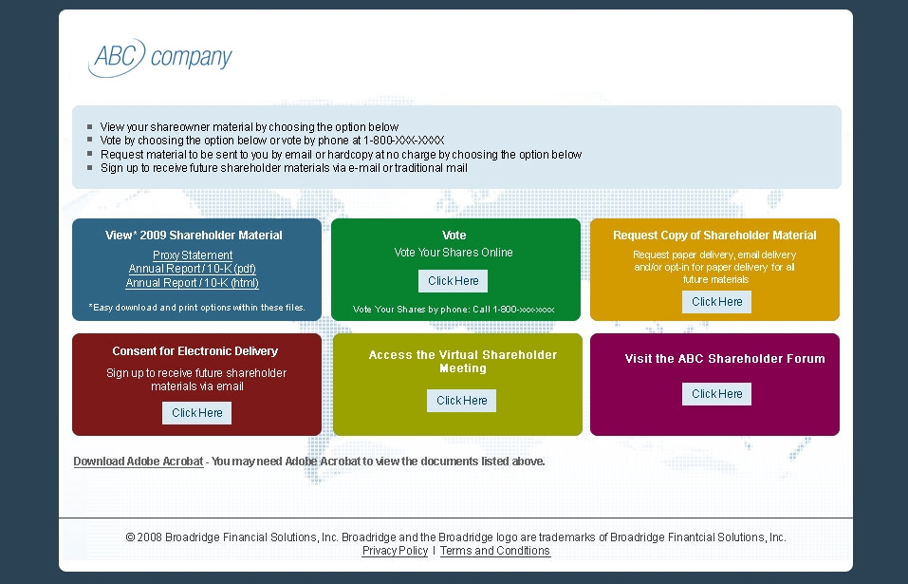
The Shareholder Forum Provides Multiple Ways to Engage Stockholders.

Slide 9
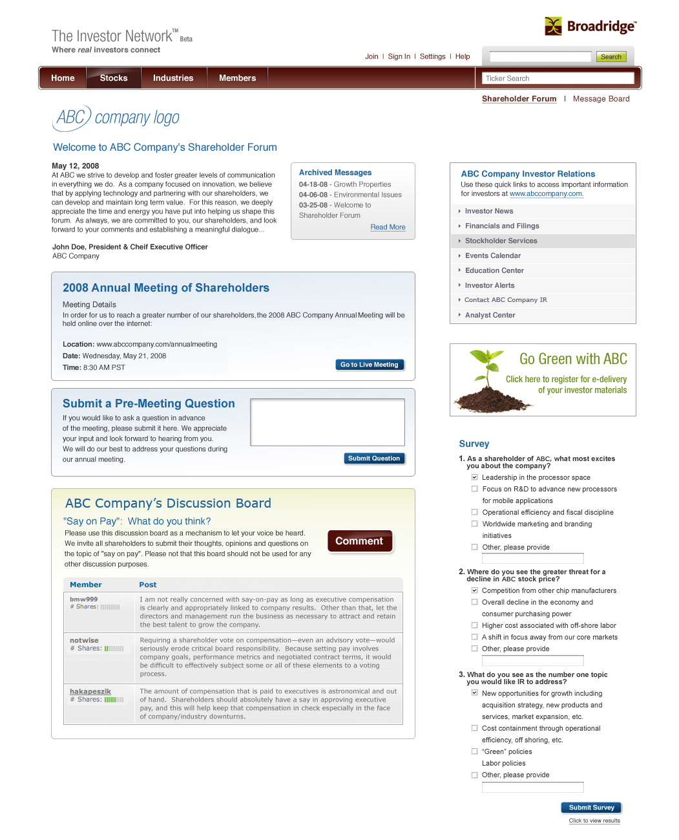
Example of Shareholder Forum Linked to the Annual Meeting
Issuers can proactively manage communications with validated shareholders -- in a controlled environment.
Benefits:
  Push information out to the shareholder and/or investor community
  Links to Investor Relations website
  Give shareholders the ability to submit questions ahead of the annual meeting and year-round
  Author blogs, host “webinars”, post videos, etc.

Slide 10
Investor Network -- Voluntary Options the Could Be Enabled by Broker-Dealers:
Examples of Capabilities for Issuers and Shareholders
Communications on any date or dates, including but not limited to a record date
Easy On-Ramp: Access by shareholders through their online brokerage accounts, email, and other means – consistent with current and new preferences
Notification by “push” not simply by pull
Pop-up reminders to vote with direct connection to a voting form -- in a separate, secure site
Two-way communications between management, directors and validated shareholders
  Communications among validated shareholders – on virtually any topic – across brokerage firms
  Anonymity and accountability, with regard to comments made
  Discussion of views and of information found in company filings
  Links to detailed biographical information on directors, that is not included in proxy statements, with streaming video and Q&A with potential candidates
Valid polls of actual shareholder sentiment. Detailed questions and unbiased surveys designed by third-party experts. High levels of confidence in the outcome of a poll.
The natural technological evolution of the proxy process. No “option” today for
issuers to use “social” solutions through broker online facilities.

Slide 11
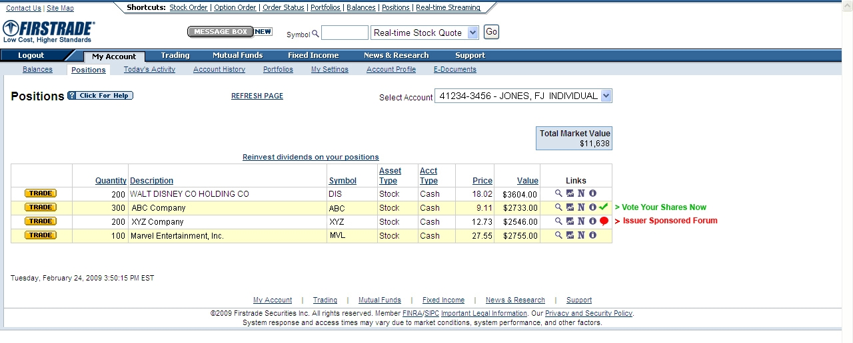
Brokerage Firms Could Provide Street Shareholders an Opportunity to Connect Easily. Example: The Investor Network Linked to an Issuer-Sponsored Forum

Slide 12
Client-Directed Voting
Accessing External Viewpoints
Expanded View of
External View Points
(Pull-down Menu)
Firm/Organization 1
Voting Guidelines Summary
Summary
Routine Proposals
Election of Directors
Compensation Proposals
Other Management Proposals
Shareholder Proposals
Notes:
Audit of voter with vote group
Vote status
Reject indicator
Sub level blocking indicator
Shares on loan details
Direct access to research for subscribing users

